Slide 1
10,000 ft View of Genomics Lab Techniques & Analyses

Slide 2
Acknowledgements
Major contributions have been made by Nicholas Hathaway and Christian Parobek to the techniques and figures seen below.
I have attempted to credit figures to the best of my ability.
These tutorial is incomplete.

Slide 3
Overview
What are “we” doing and why do we do it?
How are we doing that?
What analyses?

Slide 4
Genomics Intent (The What)
Search for and predict evolution/positive selection as it relates to drug resistance (and now diagnostic resistance)
Use meta/epidemiological data to explain the genetic events we are observing
I.e. Why is there evidence of recent selection on gene X?

Slide 5
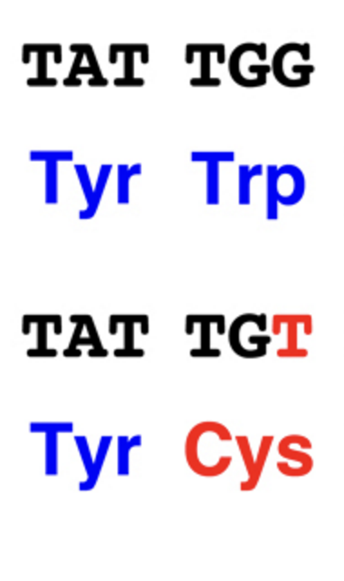
What does “evolution” mean?
Evolution
Descent with modification
(DNA) Genomics “speak”
Nonsynonymous mutations
Ok, great...How do we get these A, T, G, C bases?
A
SYN NonSyn

Slide 6
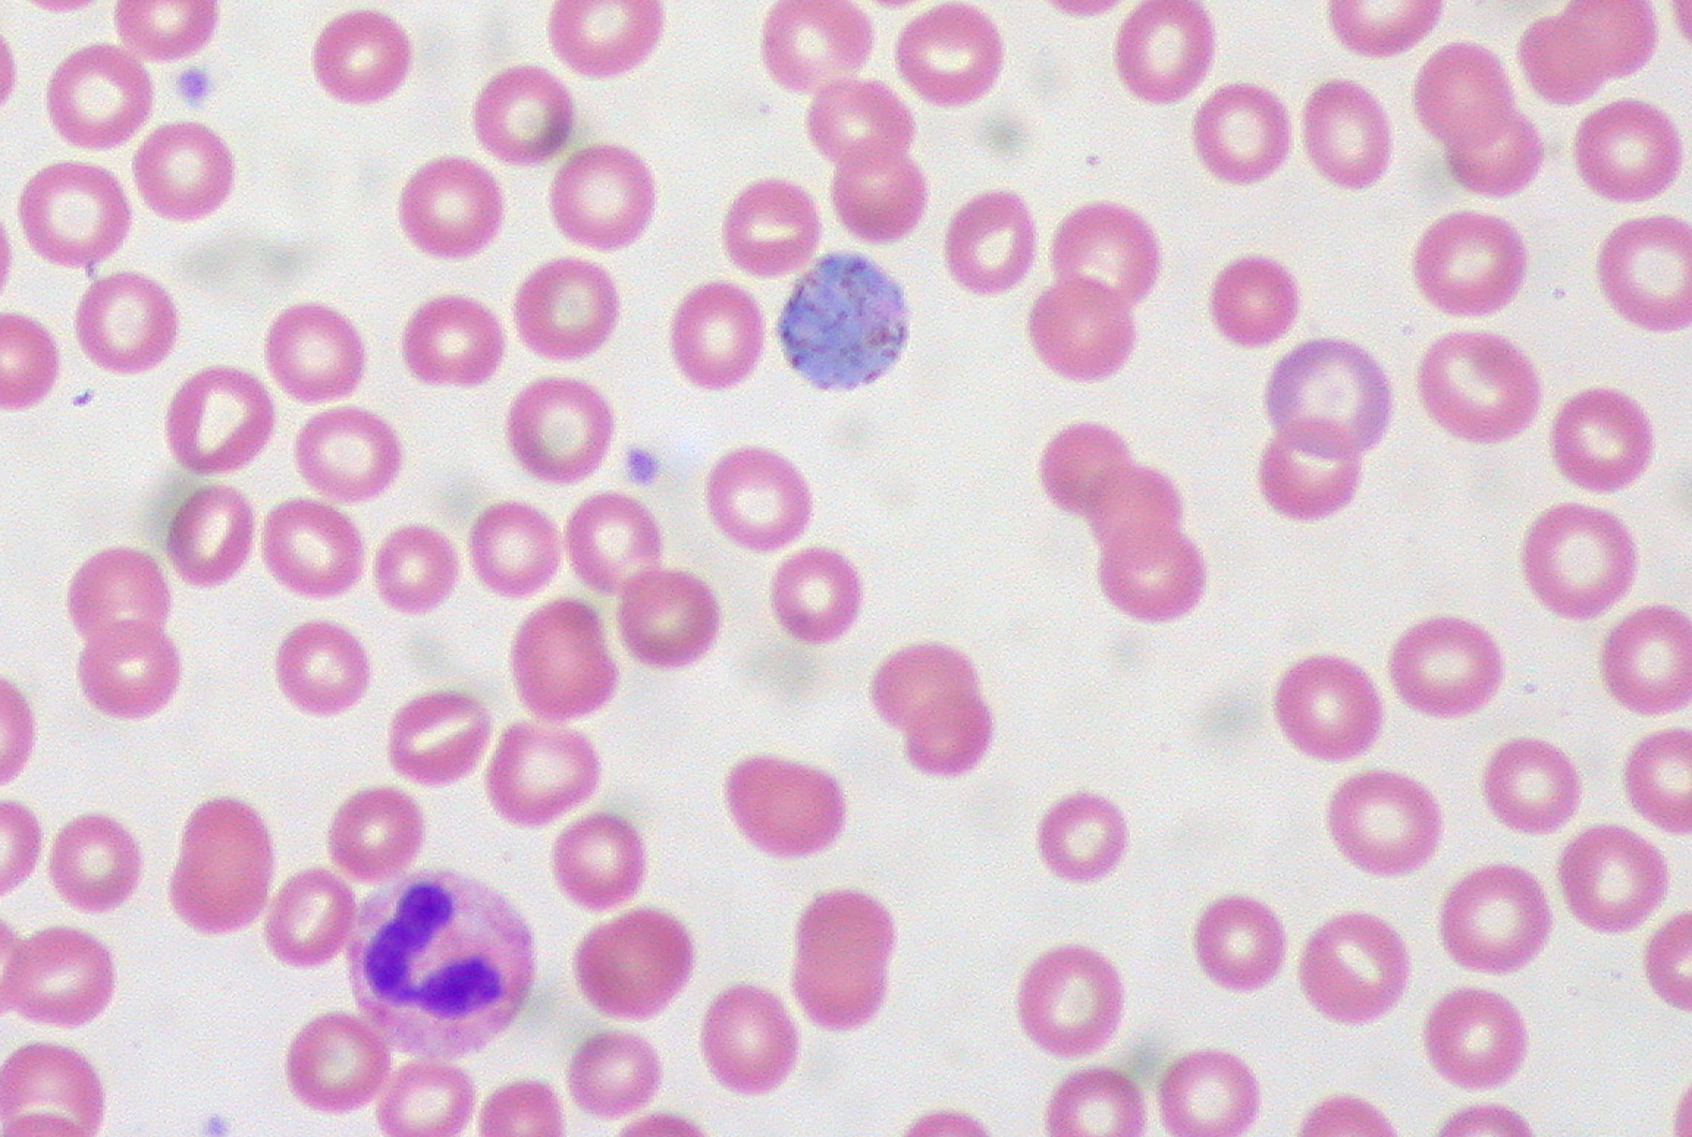
Approach (The How)
PCR
Obstacles: Human gDNA, Human mtDNA → leukodeplete
Wikicommons.com

Slide 7
Approach (The How)
Amplicon Sequencing
Targeted Amplicon Seq
Multiplex Amplicon Seq
Whole Genome Sequencing
Whole Genome Amplification
Selective WGA = fancy talk for better bioinformatics prior to WGA

Slide 8
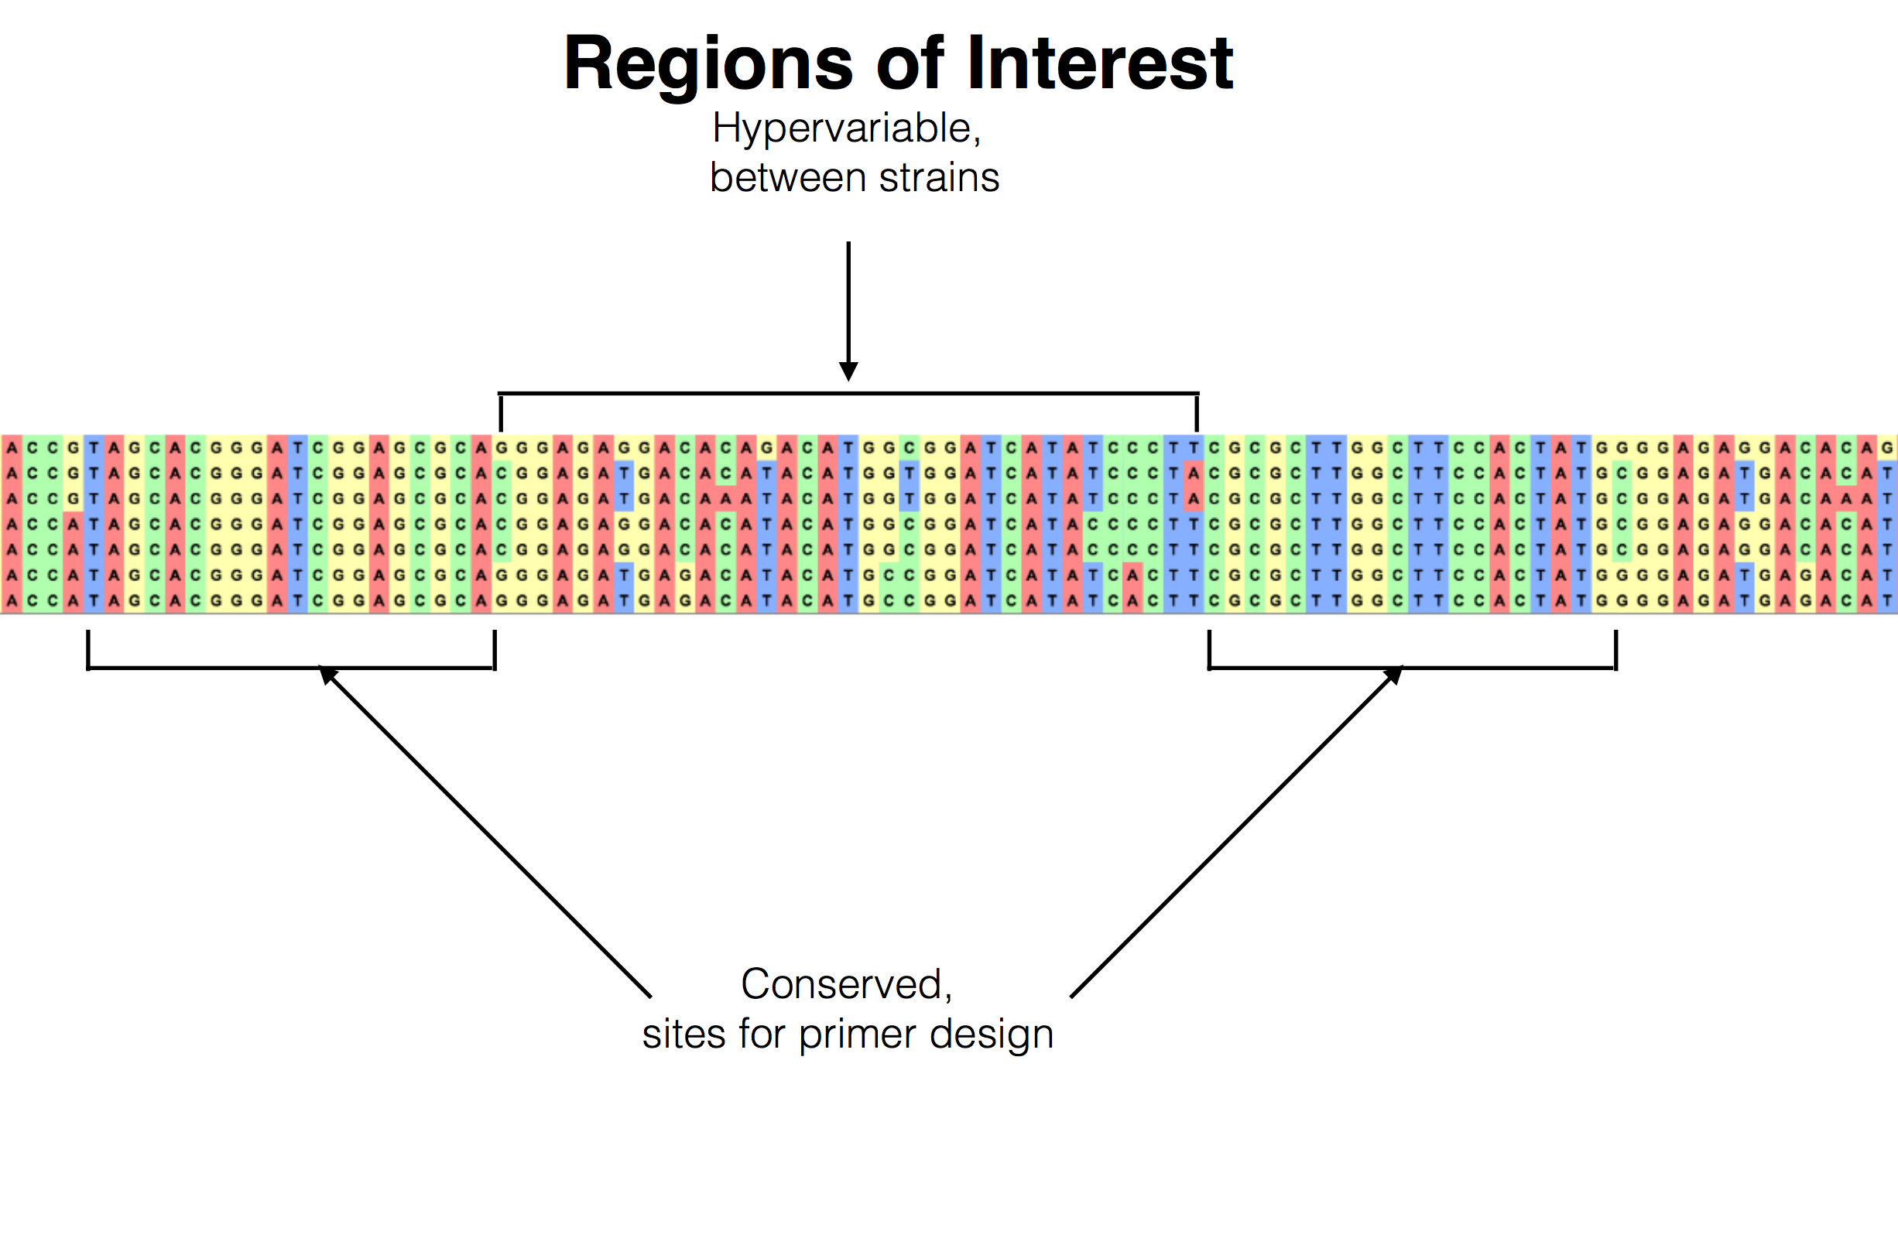
Approach (The How)
Design Primers (same idea in Amplicon & WGA)
Figure from Nick J. Hathaway

Slide 9
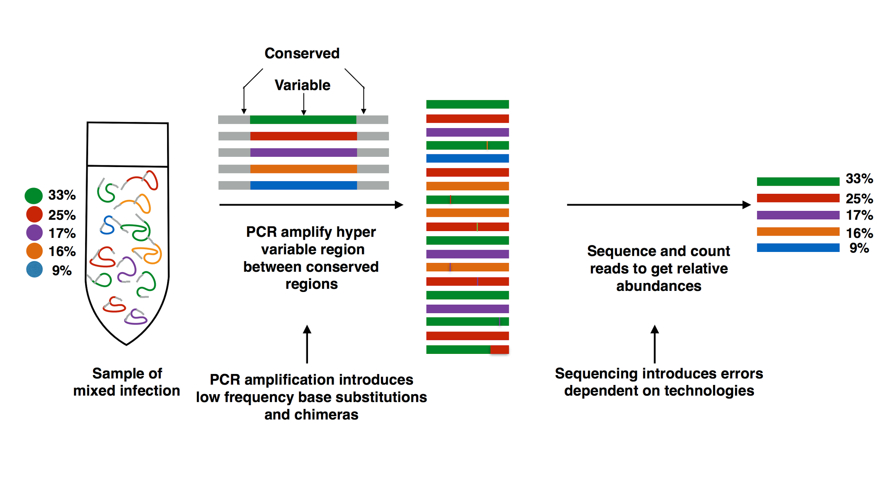
Amplicon Seq
Figure from Nick J. Hathaway

Slide 10
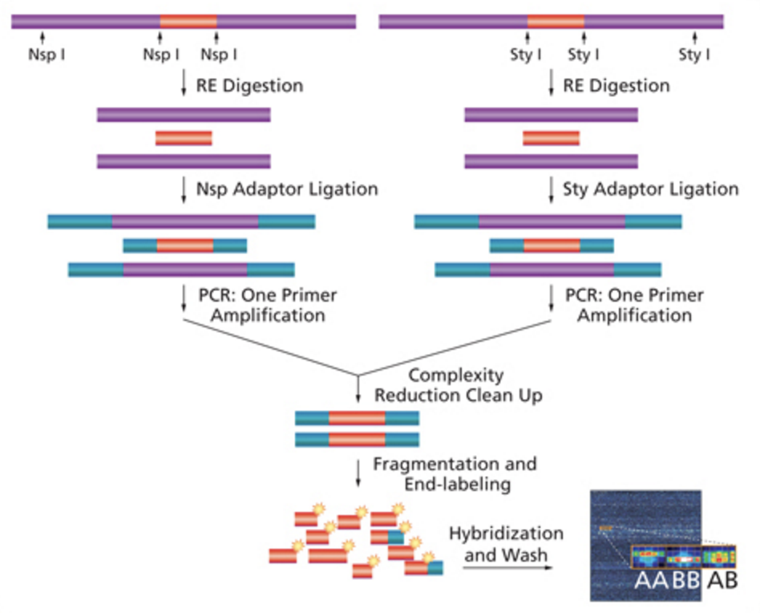
Whole Genome Amplification
Same idea as Amplicon Sequencing, except:
A few primers that will amplify the whole entire genome
Different Taq (Polymerase Phi 29)
Figure ripped from http://www.affymetrix.com/

Slide 11
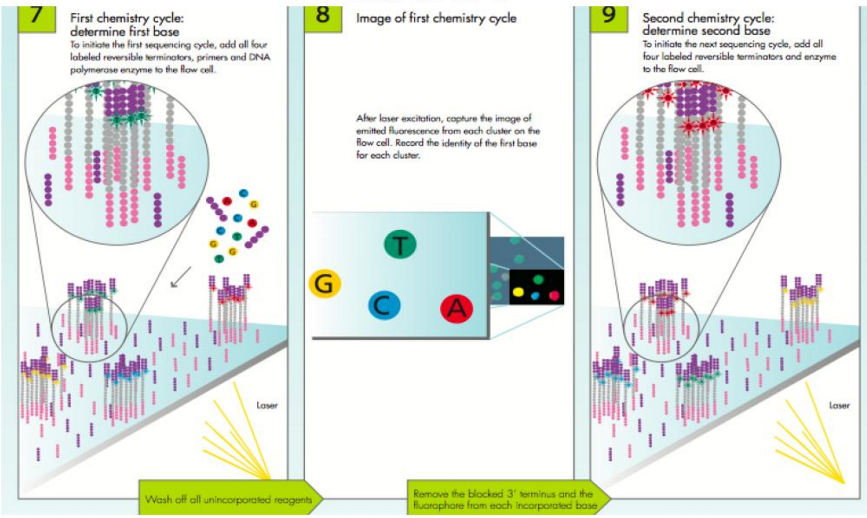
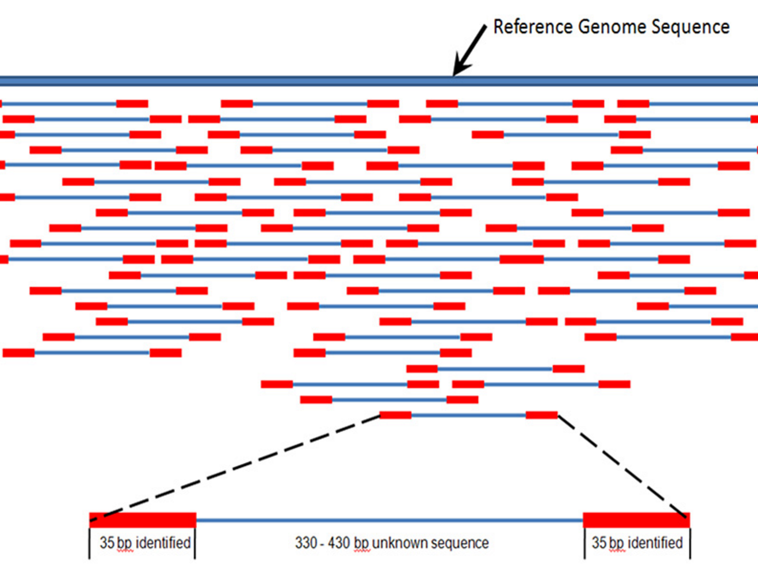
Next Gen Sequencing
Images ripped from google images, Wikipeida, etc

Slide 12
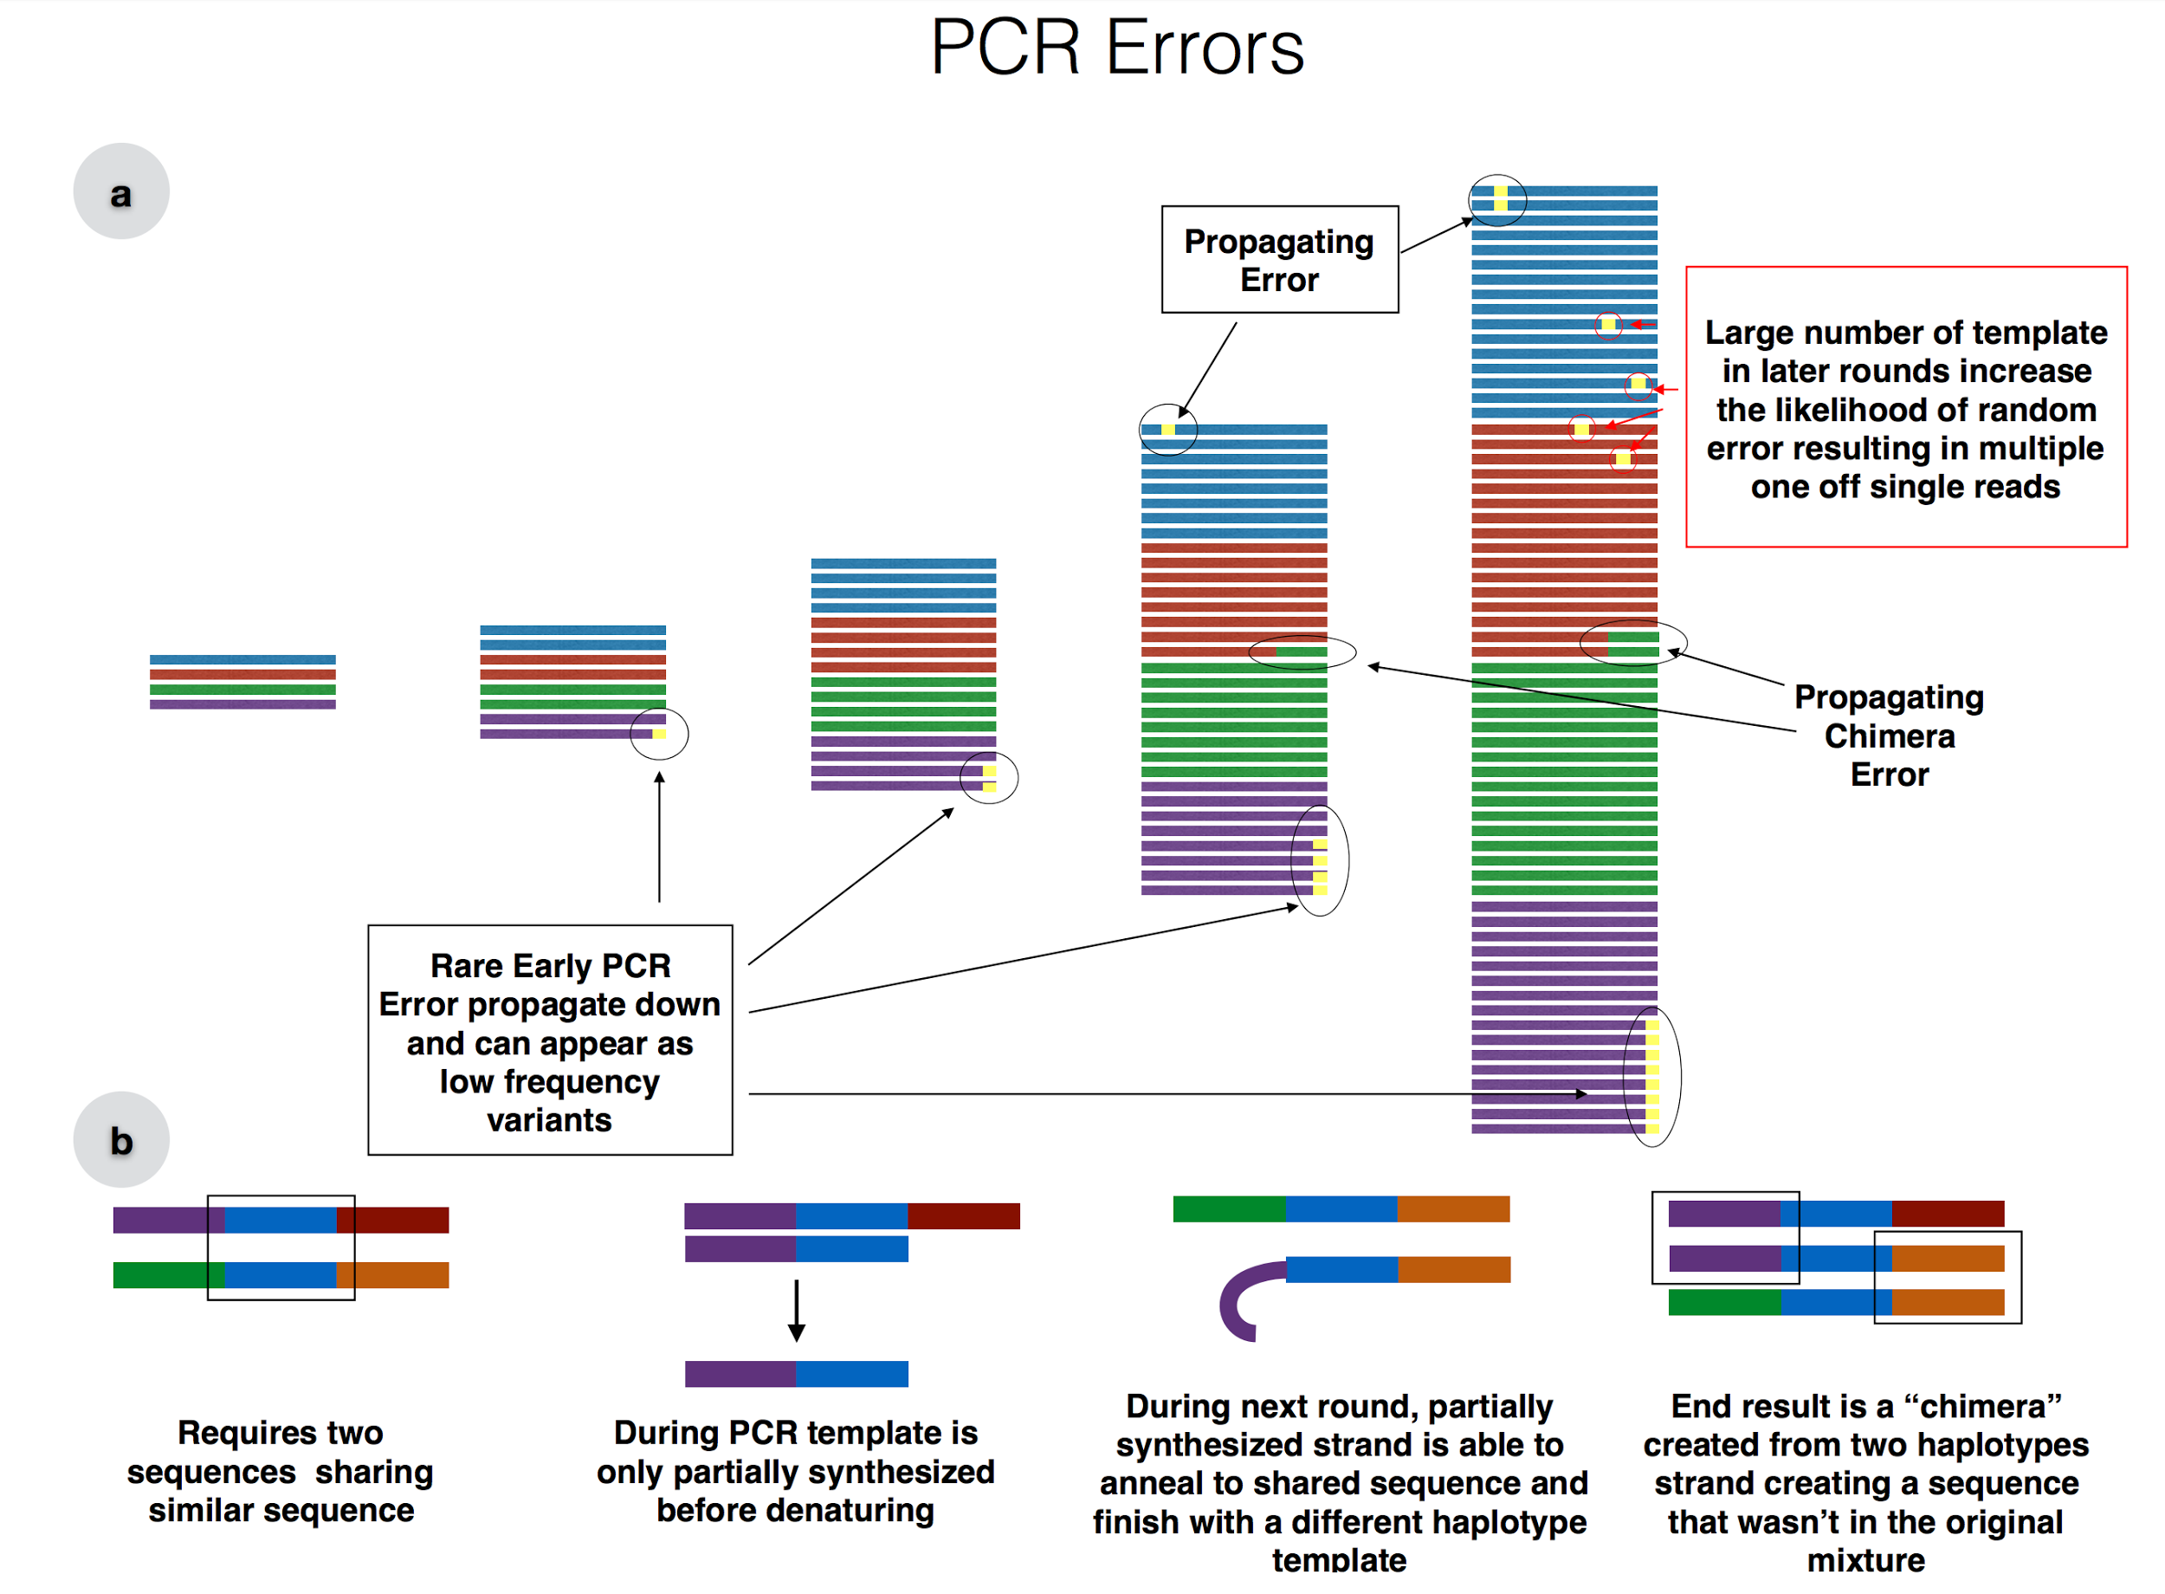
PCR ERRORS
Figure from Nick J. Hathaway

Slide 13
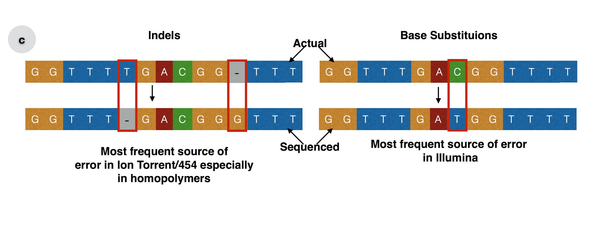
Sequencing ERRORS
Figure from Nick J. Hathaway

Slide 14


Multiclonal Infections & Multiplicity of Infection

Slide 15
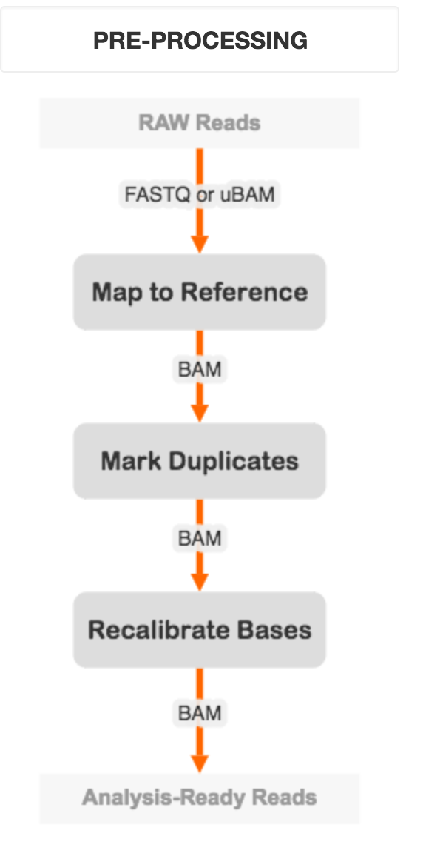
How do we resolve these errors and complexities: GATK Best Practices
Fastq
SAM/BAM
Align
Fix Mates (If Illumina)
Sort (for efficiency)
Mark Duplicates & Deduplicate
+/- Merge
Realign Indels
https://software.broadinstitute.org/gatk/best-practices/bp_3step.php?case=GermShortWGS

Slide 16
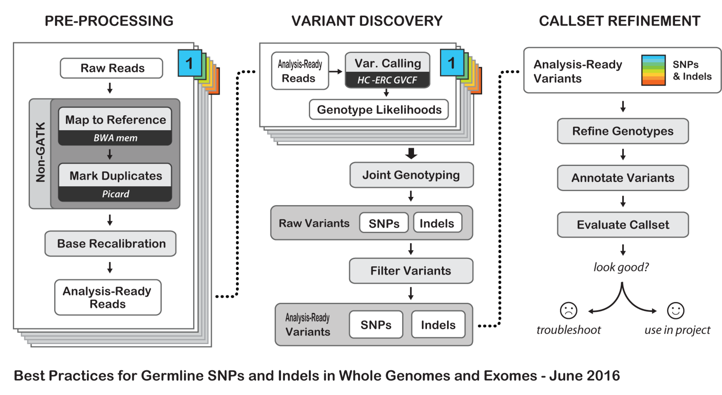
How do we resolve these errors and complexities: GATK Best Practices
Fastq
VCF
SAM/BAM
R Packages
https://software.broadinstitute.org/gatk/best-practices/bp_3step.php?case=GermShortWGS

Slide 17
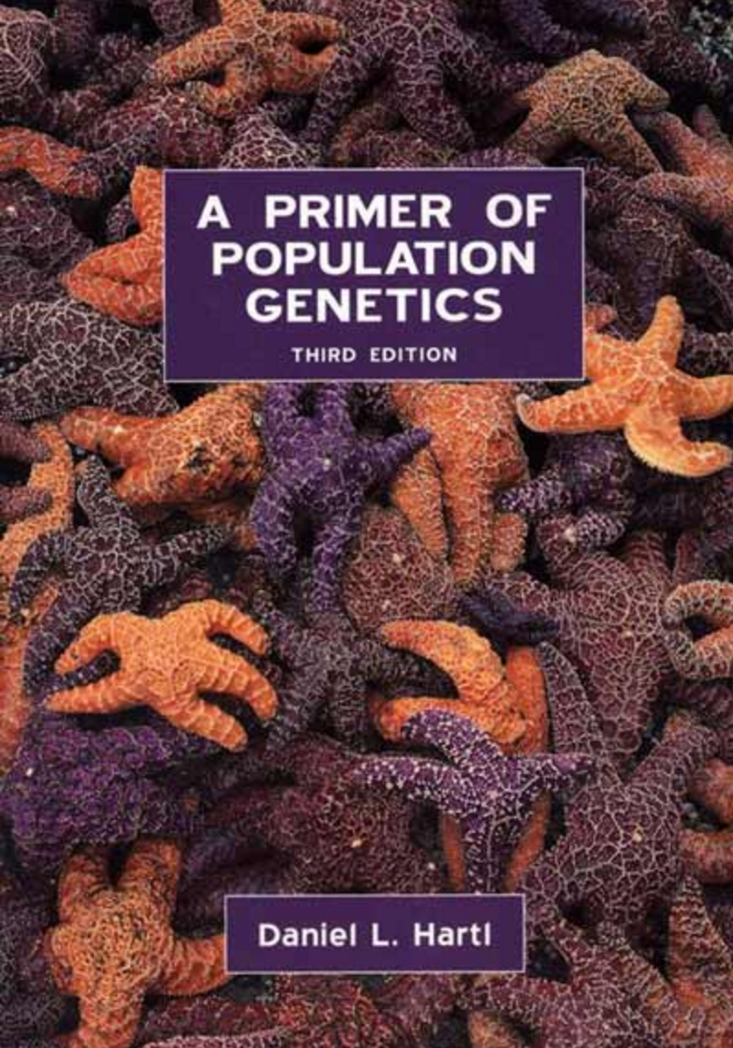
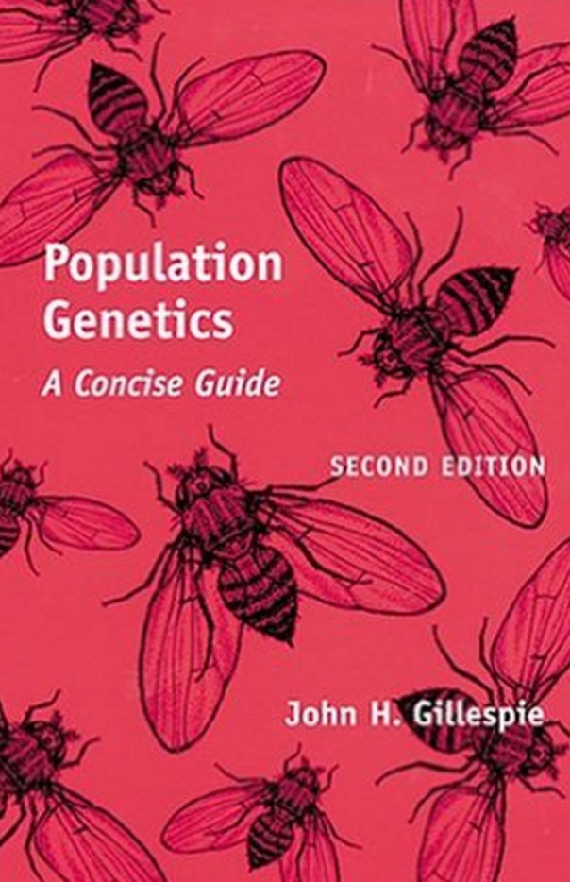
Resources
R Packages
PEGAS
ADEGENET
APE
Other Programs
Mega
DNA Star
Geneious
Websites
https://software.broadinstitute.org/
http://samtools.sourceforge.net/

